Slide 1
Research of Machine Learning in User Experience Field AUG, 16th , 2016 UEX Team – Princeton, NJ
Sam Zheng, Dou Qi, Baoxiang Wang, Tongfang Sun

Slide 2

About
Machine Learning (ML)
“Machine learning is a subfield of computer science that evolved from the study of pattern recognition and computational learning theory in artificial intelligence.”
- Wiki
“Field of study that gives computers the ability to learn without being explicitly programmed.”
- Arthur Samuel, in 1959

Slide 3

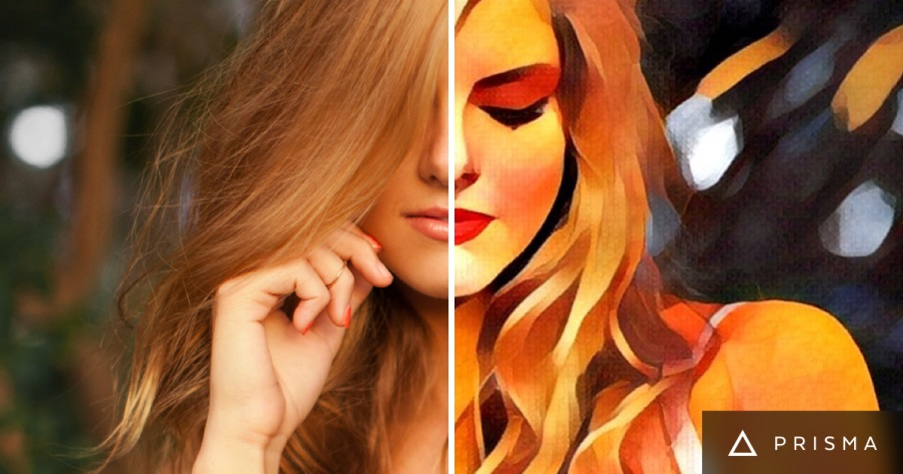
About
Approaches
Decision Tree Learning
Artificial Neural Network
Deep Learning
Reinforcement Learning
Clustering
Bayesian network
……
e.g. Convolutional Neural Network (CNN)

Slide 4
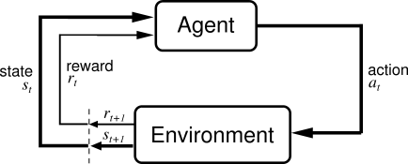

About
Approaches
Decision Tree Learning
Artificial Neural Network
Deep Learning
Reinforcement Learning
Clustering
Bayesian network
……
eg. Reinforcement Learning

Slide 5
Machine Learning and User Experience
Why we need this?
Machine Learning is like our eyes and brains, we want to use that to train our visual design and use that to improve design logic by learning user behavior

Slide 6


Machine Learning and User Experience
What we did?
Website Aesthetics
User Behavior and Game Strategy

Slide 7

Website Aesthetics
Background
Webpage Aesthetics are a decisive factor for engaging users online
Users’ Aesthetics
Estimate a good design of a webpage
Complexity
Color scheme
Balance
Texture
…

Slide 8

Website Aesthetics
Background
Machine’s Aesthetics
Let computer learn to automatically estimate webpage aesthetics from big data
Identify and quantify key image features that are predictive of favorable aesthetic judgements by individuals

Slide 9

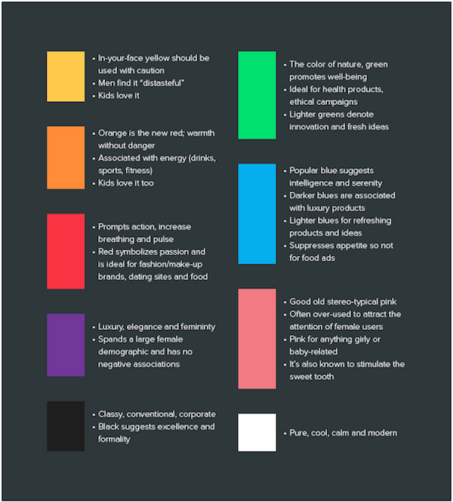
Website Aesthetics
Related Works
Webpage aesthetics rating with hand-crafted features from color, context, space layout
Correlating low-level image statistics with users’ rapid aesthetics and affective judgments of webpages , Xianjun Sam Zheng et al. CHI’09
Predicting users’ first impression of website aesthetics with a quantification of perceived visual complexity and colorfulness , Reinecke et al. CHI’13
Complexity and Colorfulness

Slide 10
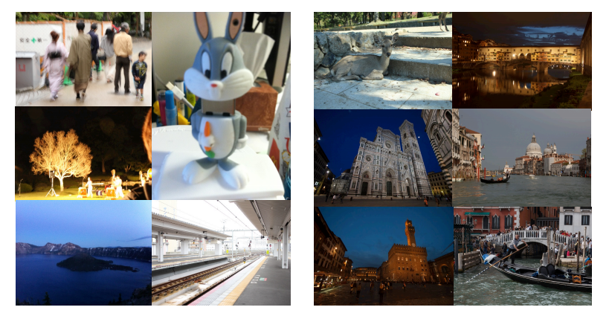
Website Aesthetics
Related Works
Photo aesthetics rating with deep learning features from convolutional neural networks
Deep multi-patch aggregation network for image style, aesthetics, and quality estimation, Lu et al. ICCV’15
Photo aesthetics ranking networks with attributes and content adaptation, Kong et al. ECCV’17
Low Quality
High Quality
Lu et al. ICCV’15

Slide 11
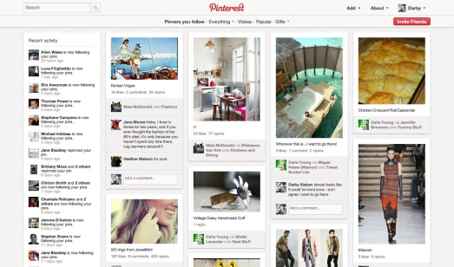
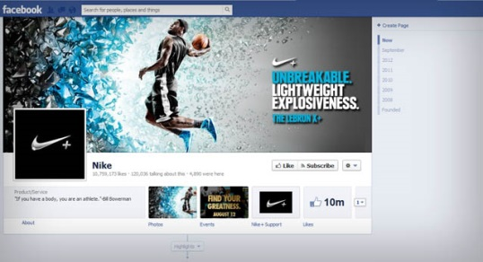


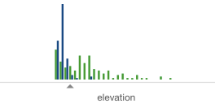
Website Aesthetics
Method
Webpages
Deep Neural Network
Learn webpage aesthetics from big data
Rate new webpages automatically
CNN algorithm
Rating

Slide 12
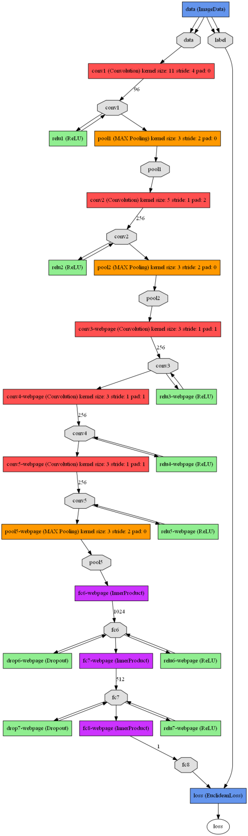
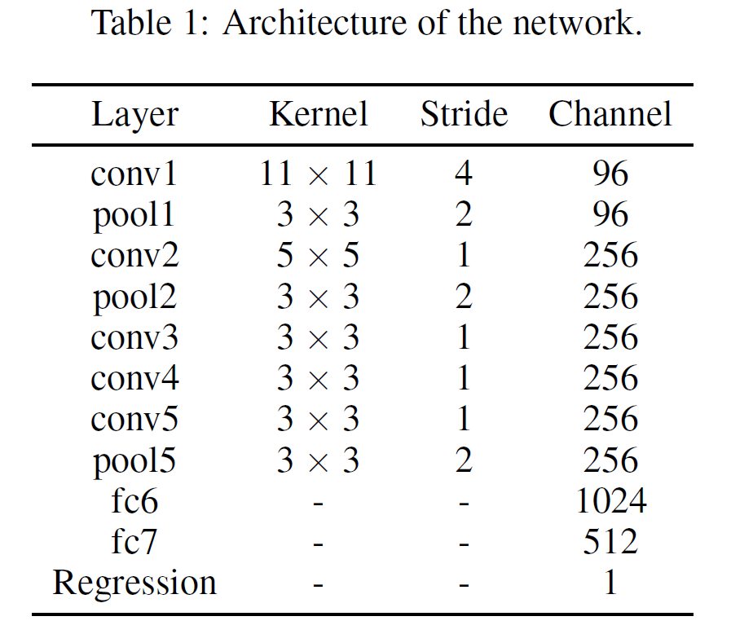
Website Aesthetics
Method
Deep Neural Network
11 layer convolutional neural networks

Slide 13
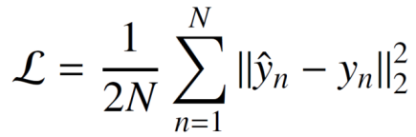
Website Aesthetics
Method
Deep Neural Network
11 layer convolutional neural networks
Regression to an output rating
Minimize Euclidean distance
Stochastic gradient descent to update weights in optimization

Slide 14
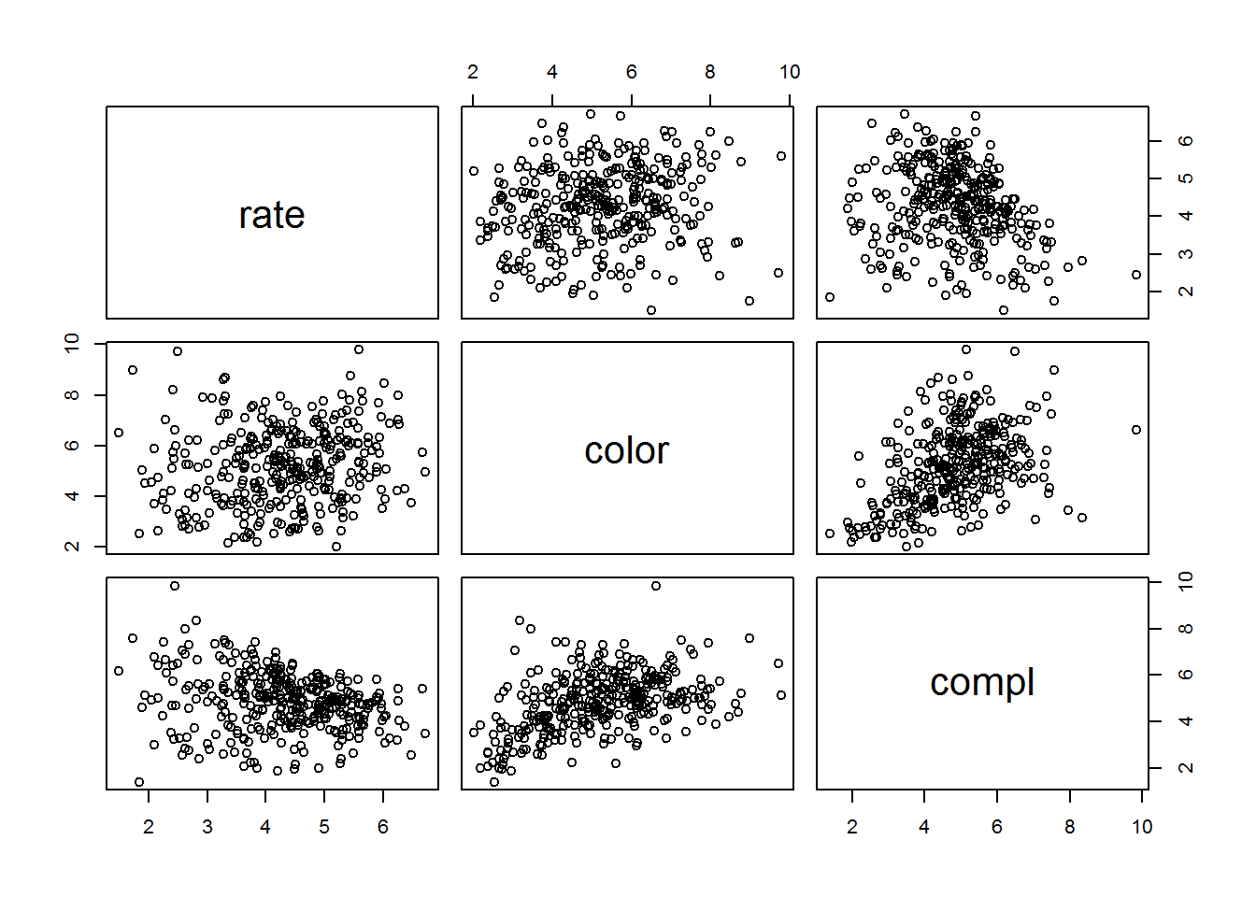
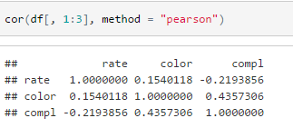
Website Aesthetics
Method
Linear regression (baseline comparison)
hand-crafted complexity and colorfulness
Rate, colorfulness and complexity Pearson Correlation

Slide 15
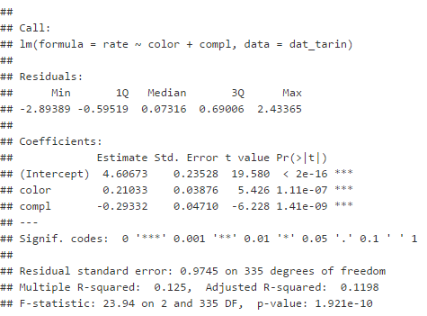
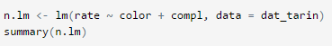
Website Aesthetics
Method
Linear regression (baseline comparison)
Build fixed normal linear regression to find correlation

Slide 16
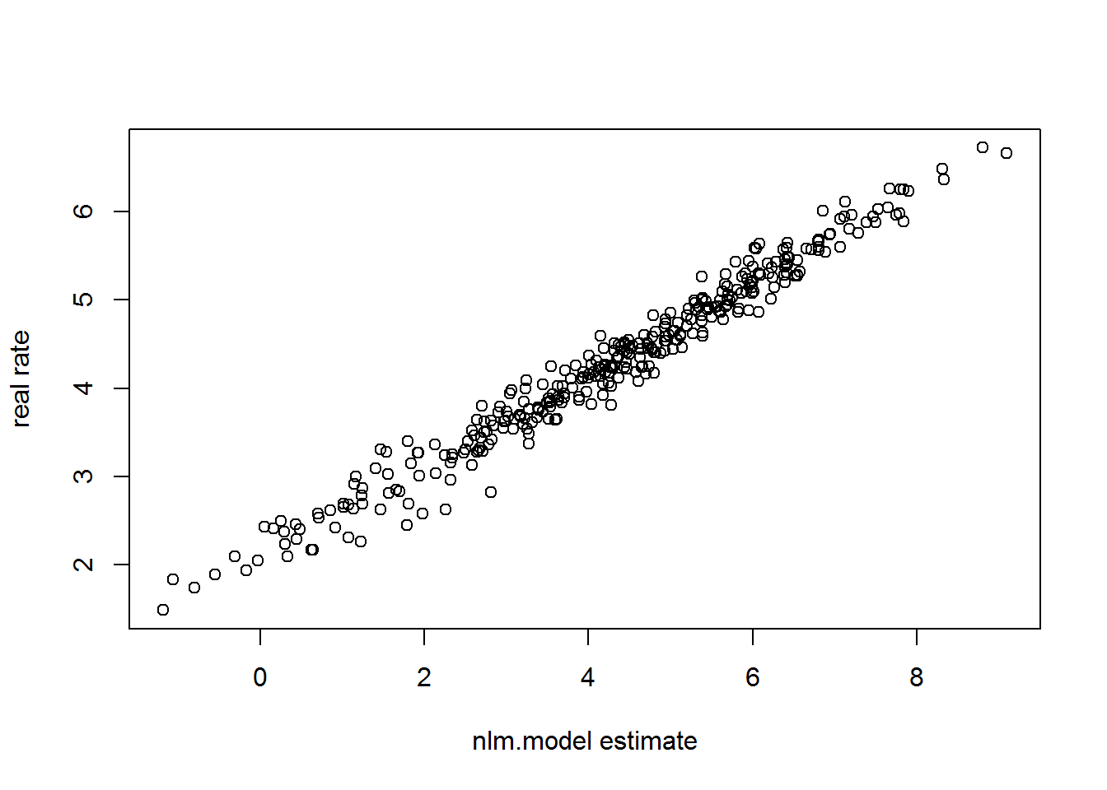
Website Aesthetics
Method
Linear regression (baseline comparison)
Build fixed normal linear regression to find correlation

Slide 17
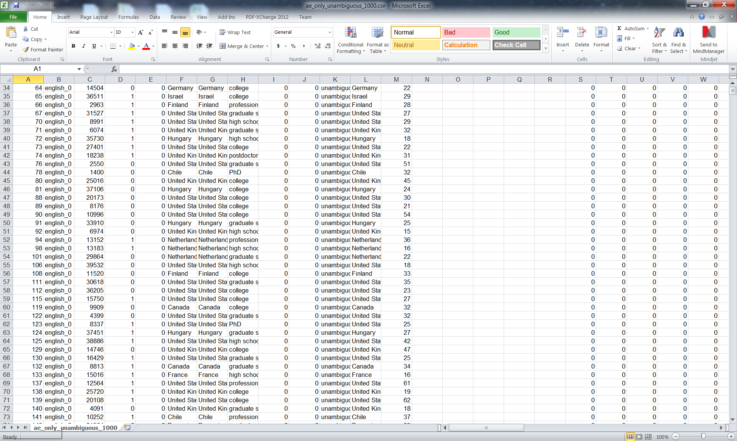
Website Aesthetics
Experiment
Dataset
398 webpages (languages of English and Foreign)
300 training (75.4%), 38 validation (9.5%), 60 testing (15%)
Users rating from 40000 people, averagely each webpage received 1000 ratings

Slide 18
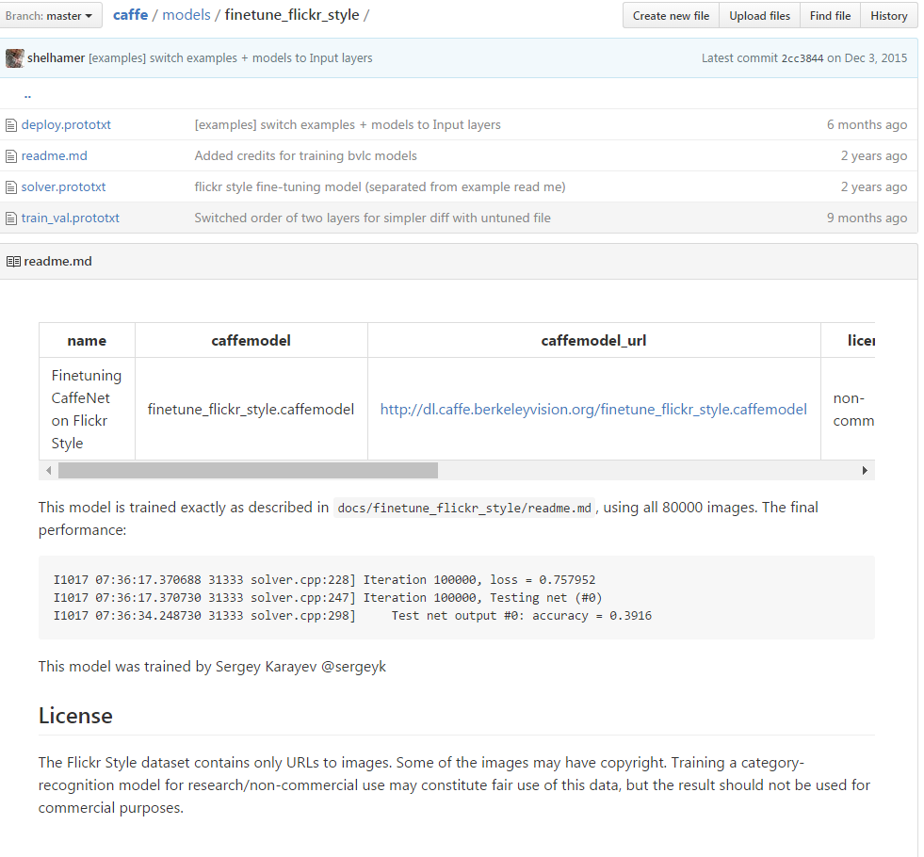
Website Aesthetics
Experiment
Network Training
Fine-tune CaffeNet pre-trained on Flickr dataset for image style recognition
Initialize the first two convolutional layers
Sampling Strategy
Use average rating from users (overfitting)
Use all ratings from users (too much noise)
Remove rating outliers (bias)
Randomly sample user ratings

Slide 19
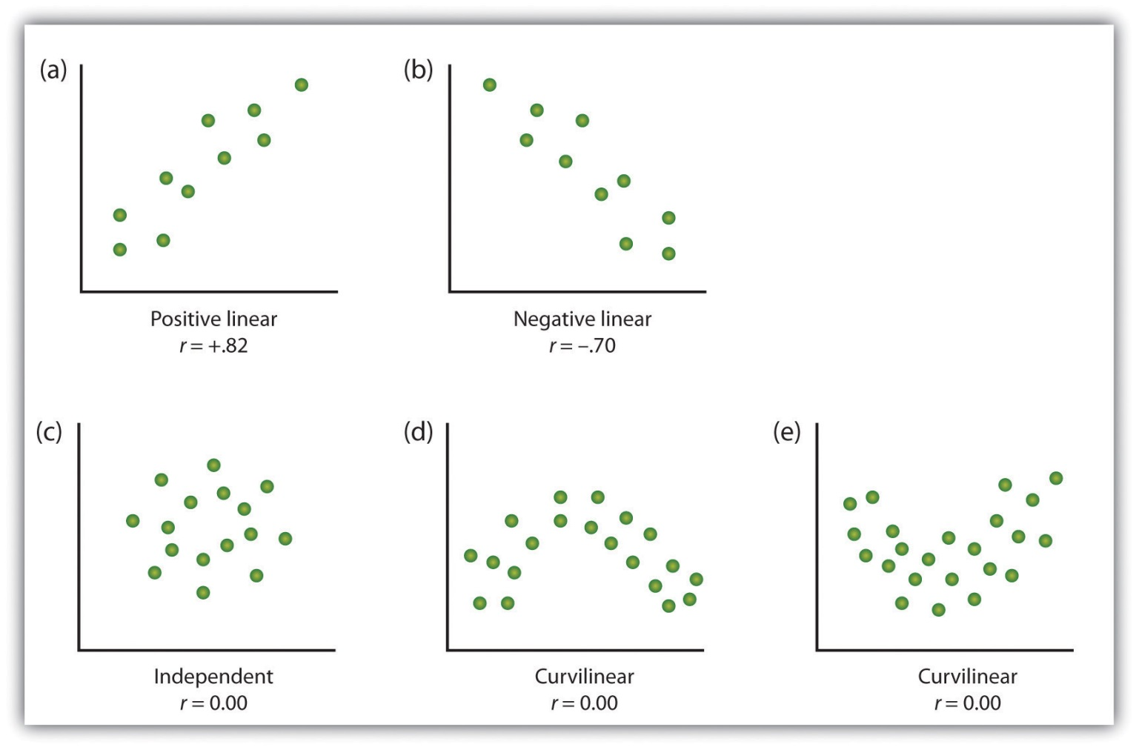
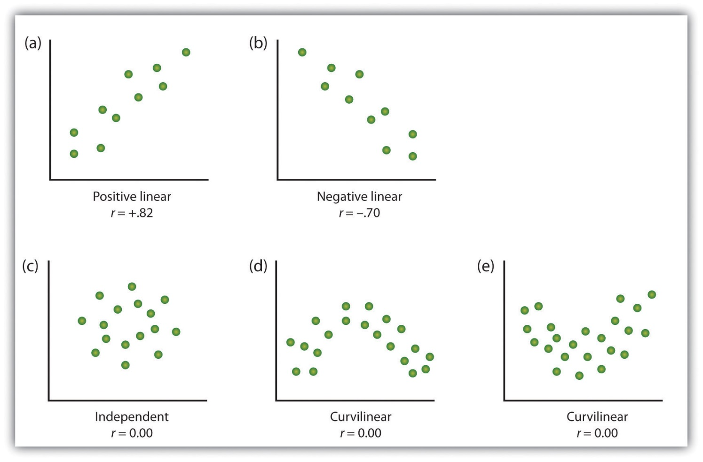
Website Aesthetics
Results
Quantitative Evaluation metric
Pearson correlation r: measurement of the linear relationship between our prediction results and users’ ratings

Slide 20
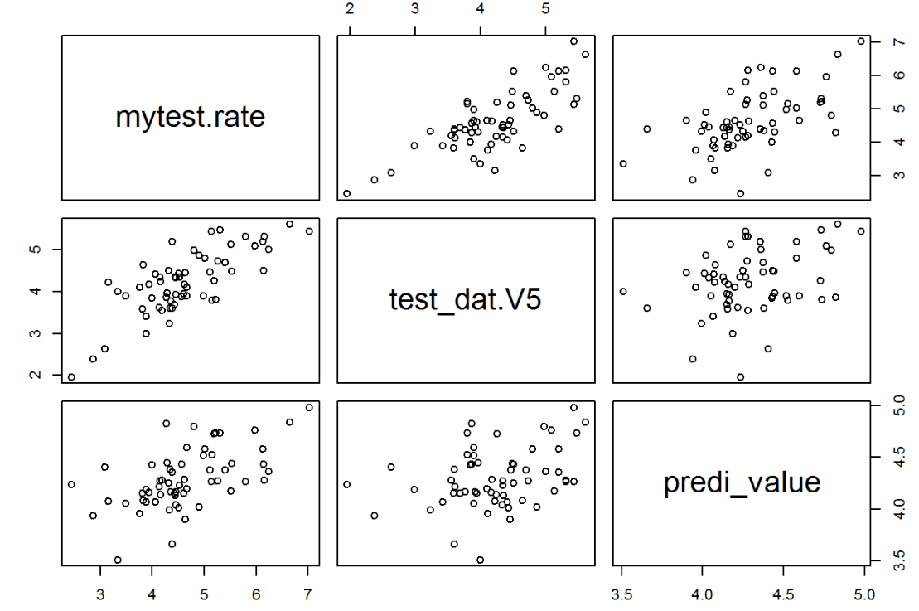
Website Aesthetics
Results
Ground Truth
Scatter plots of prediction results
CNN
r = 0.76
p < 0.001
Linear Regression
r = 0.57
p < 0.001

Slide 21

Website Aesthetics
Results
Examples of webpage rating prediction
Users’ rating: 4.44
CNN prediction: 4.35
Linear Regression: 4.13

Slide 22
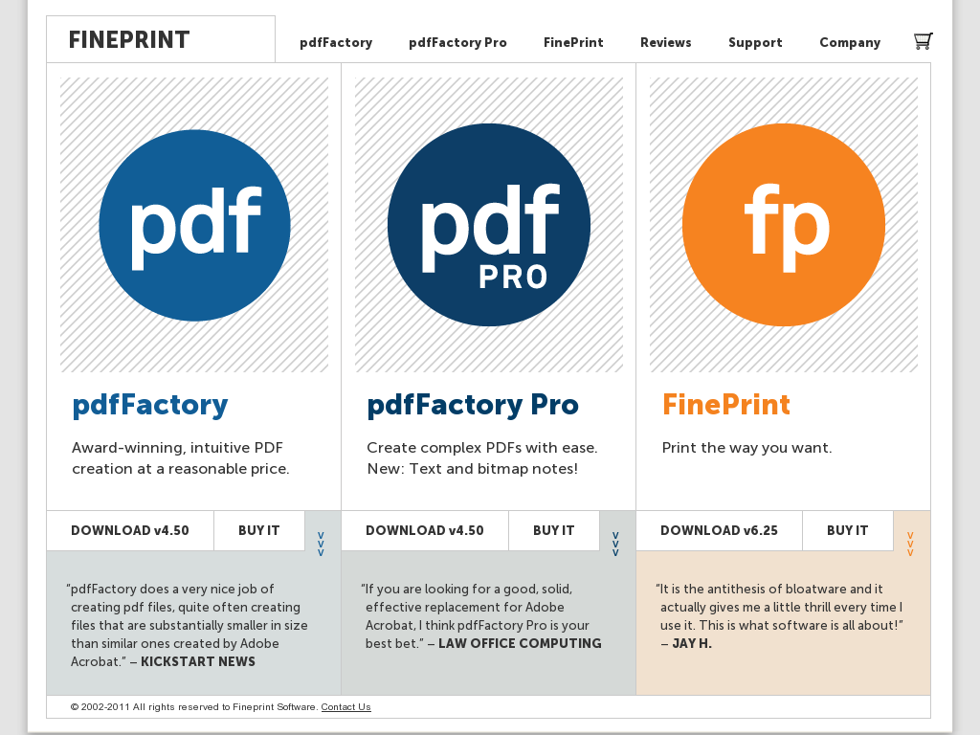
Website Aesthetics
Results
Examples of webpage rating prediction
Users’ rating: 5.14
CNN prediction: 4.43
Linear Regression: 4.26

Slide 23

Website Aesthetics
Results
Examples of webpage rating prediction
Users’ rating: 7.03
CNN prediction: 5.43
Linear Regression: 4.98

Slide 24
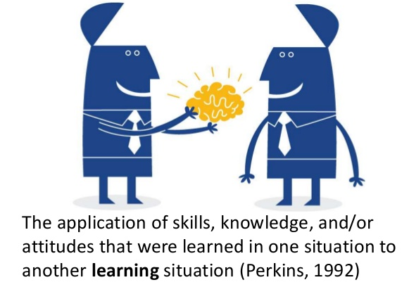
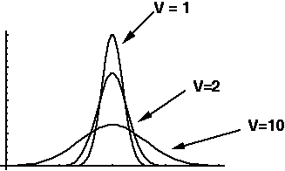
Website Aesthetics
Future
Analyze the value of knowledge transfer from network for image style recognition
Study the rating variance among different user populations
Equip network with the capability to predict the variance

Slide 25


Slide 26
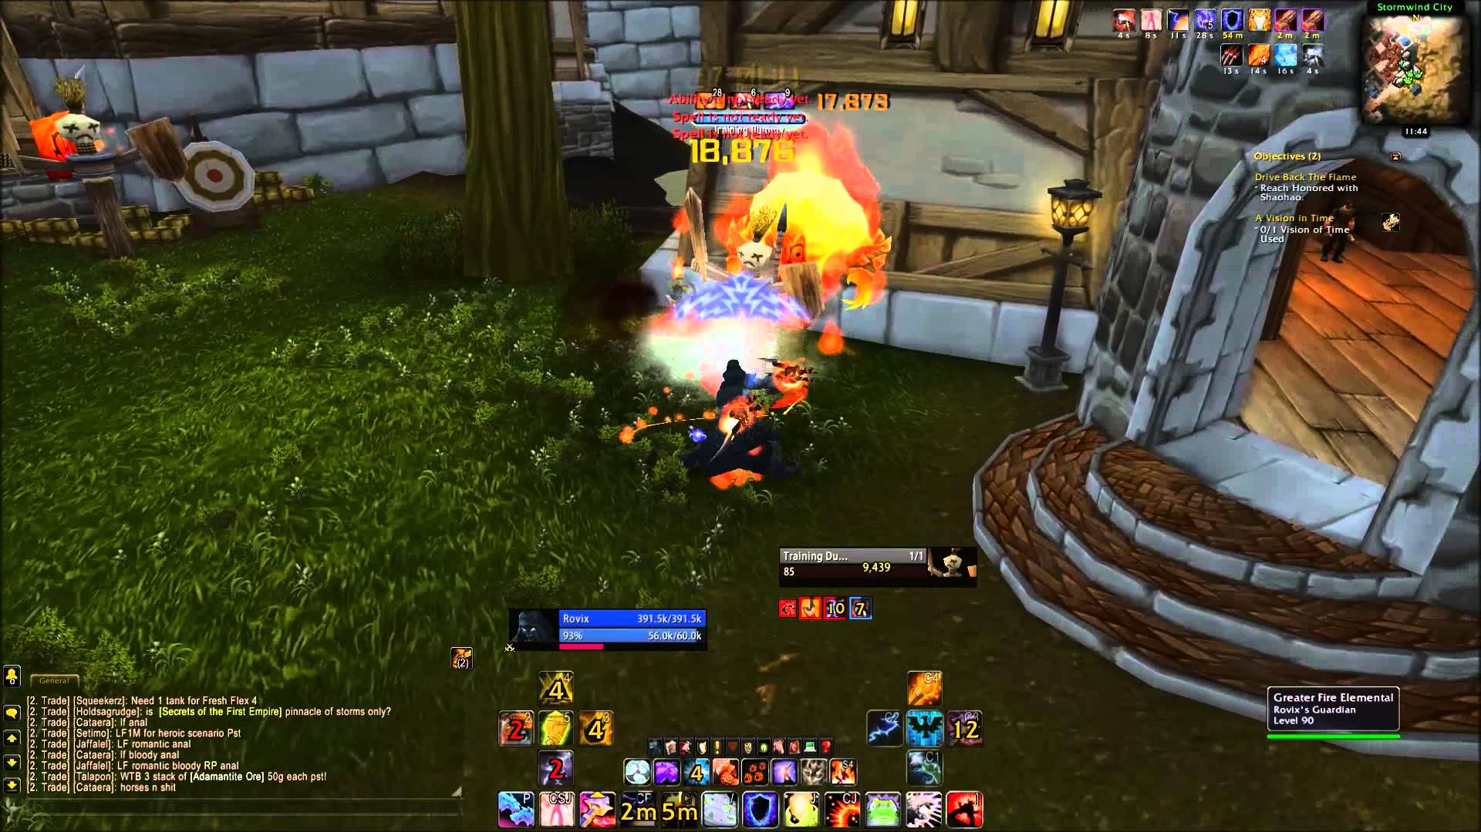
World of Warcraft
About
World of Warcraft (WoW) is a massively multiplayer online role-playing game (MMORPG) released in 2004 by Blizzard
Third- or first-person view,
Exploring the landscape
Fighting various monsters
Completing quests,
Interacting with non-player characters (NPCs) or other players

Slide 27
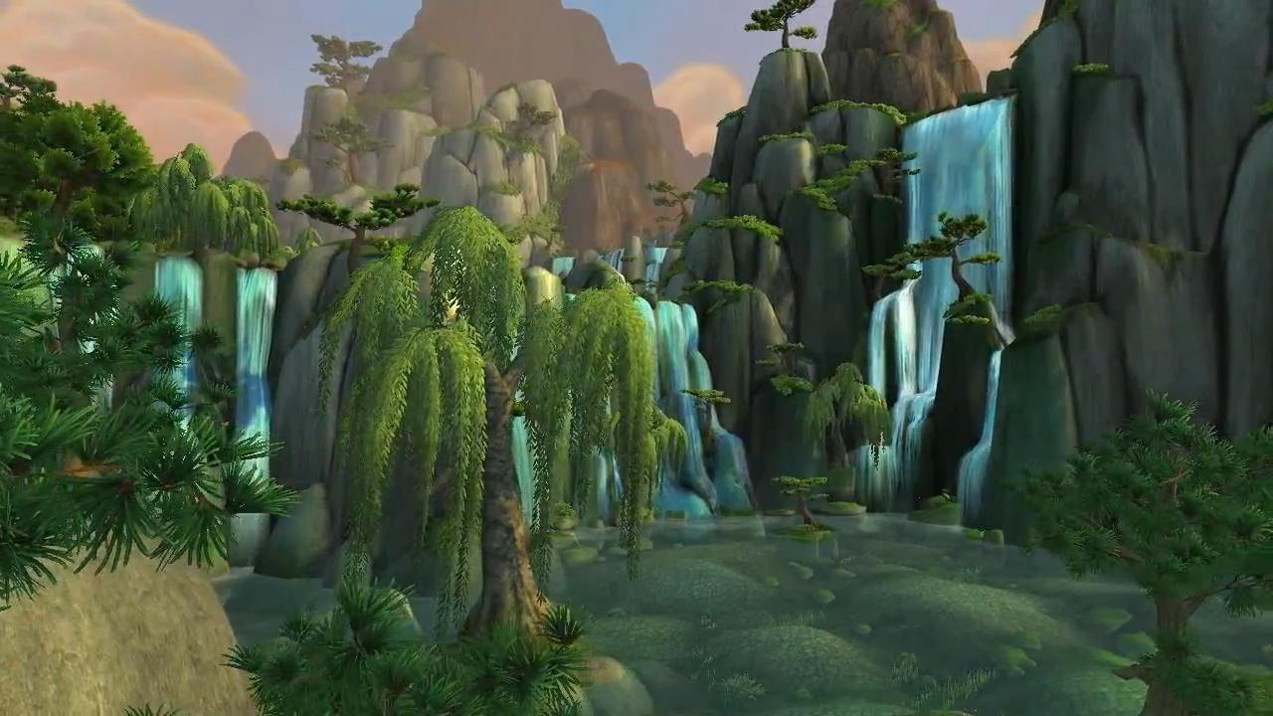
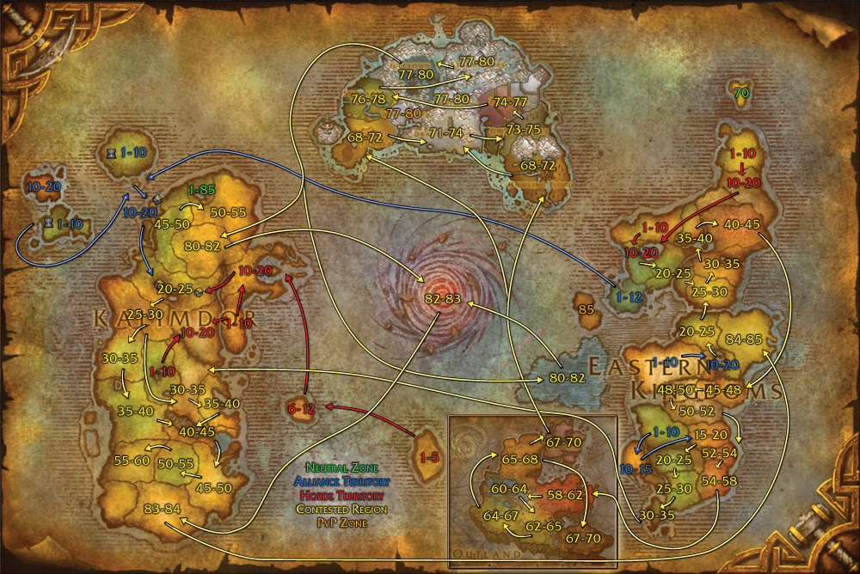
World of Warcraft
Zone

Slide 28
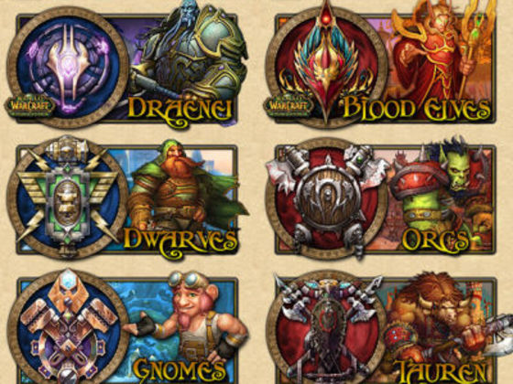

World of Warcraft
Race and Career

Slide 29
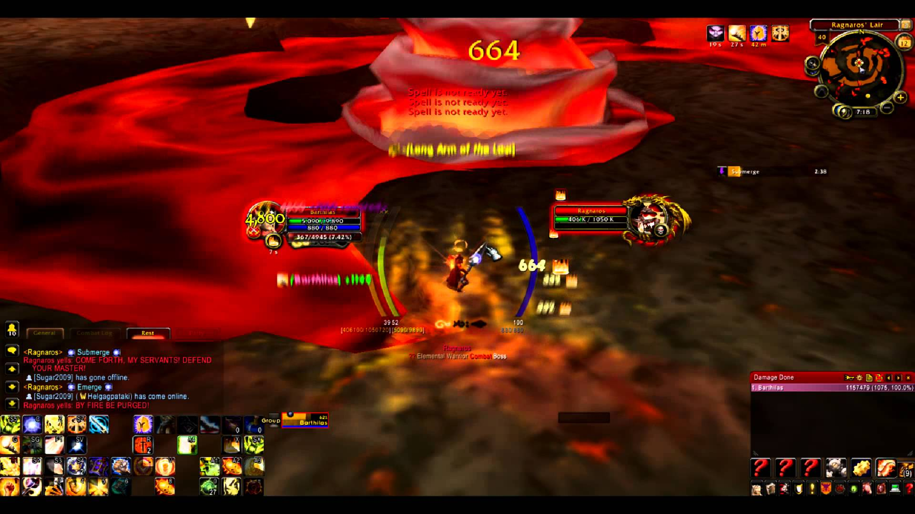
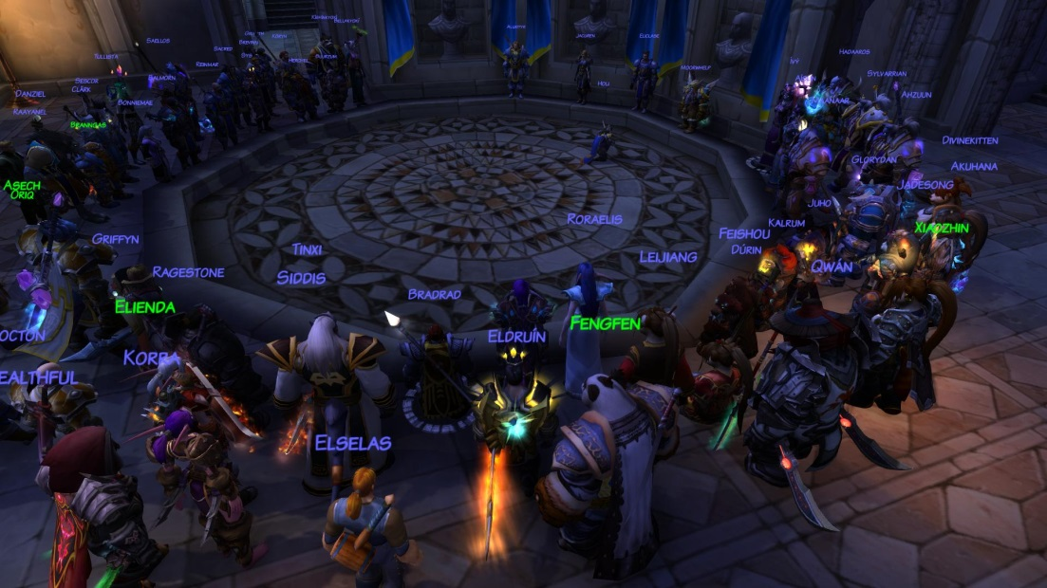
World of Warcraft
Guild

Slide 30
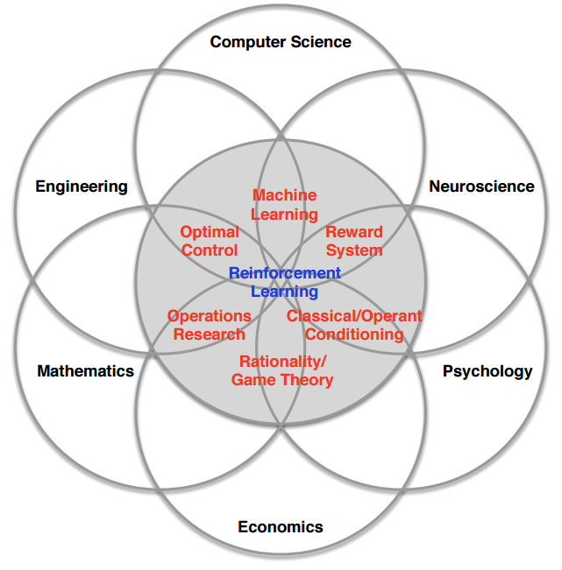
Reinforcement Learning
About
An agent play with an environment
To maximize reward
E.g. maximize user experience, win a Go game
Relation with deep learning
RL to formulate problem
DL to solve problem

Slide 31

Reinforcement Learning
About
Recent advances in RL
Mastering game of Go (Deepmind, Nature 2016)
Playing Atari games (Deepmind, Nature 2015)
RL for User Behavior Analysis and Design

Slide 32
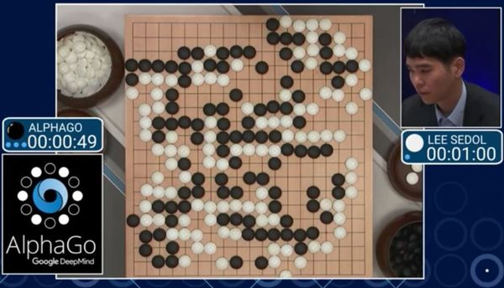
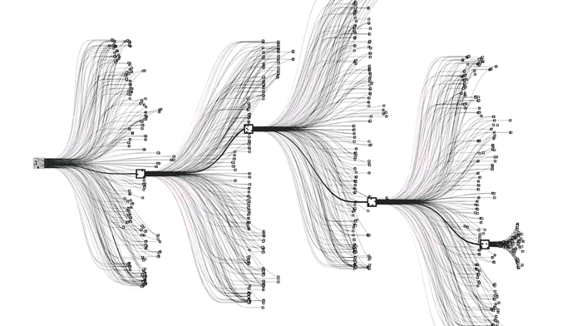
Reinforcement Learning
About
Mastering the Game of Go
A feat previously thought to be at least a decade way

Slide 33

Reinforcement Learning
About
Mastering RL for UBA and Design
We treat user as agent, and try to
Model how users perform actions, i.e. predict the next user action/state
Model the “experience” of users, quantitatively, i.e. have a tell of “what is a good experience”
To do this, we elaborate several
Deep Q-Networks
Inverse Reinforcement Learning

Slide 34
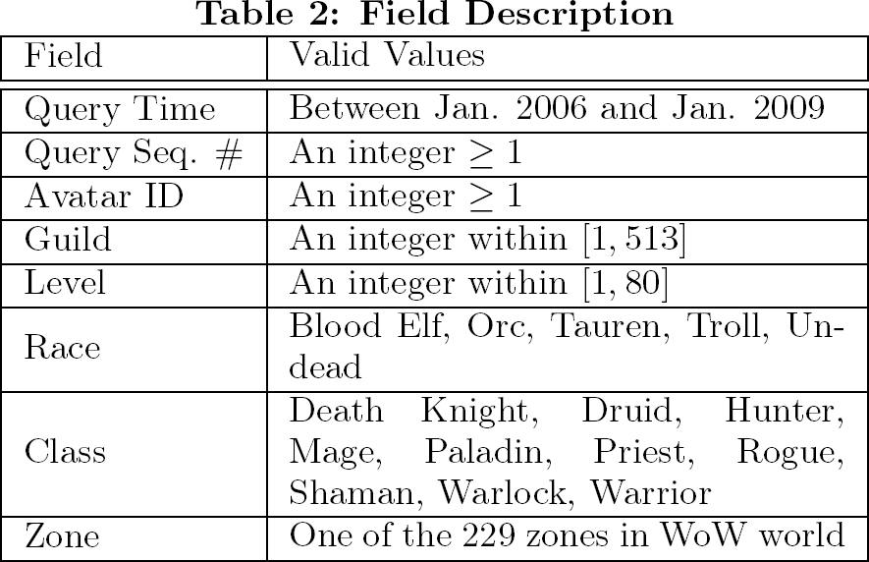
World of Warcraft
Dataset
Dataset provided by World of Warcraft Avatar History (WoWAH)
70,000 users
Every 10 mins during 2005-2008
The current zone (location)
Other contextual information

Slide 35
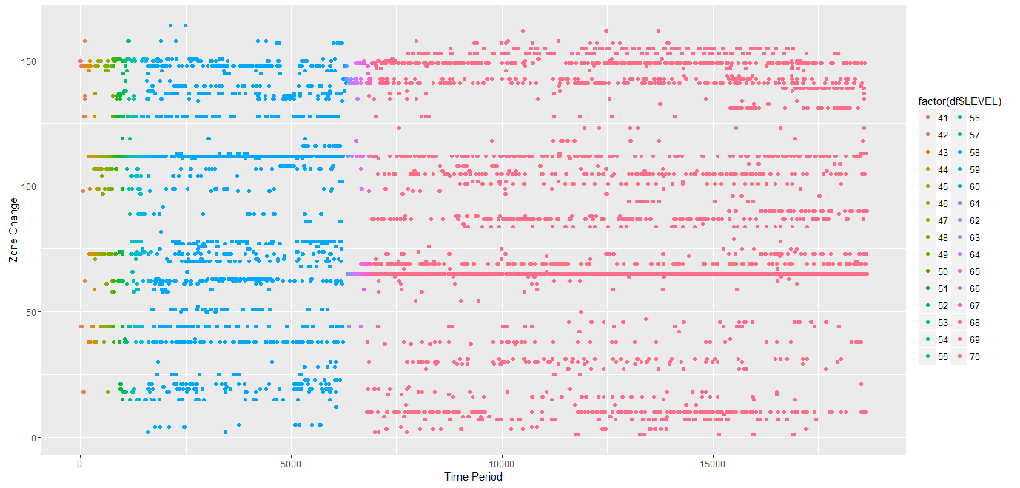
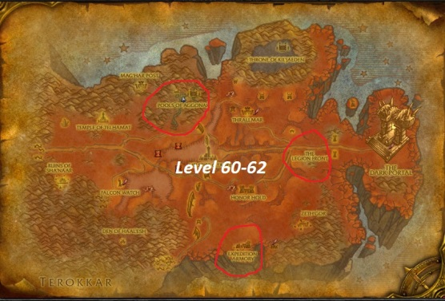
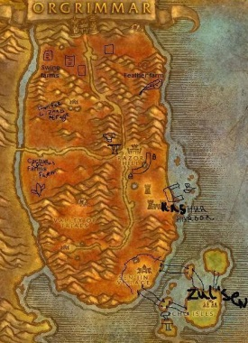
World of Warcraft
Dataset player ID 31

Slide 36
World of Warcraft
Dataset player ID 31

Slide 37
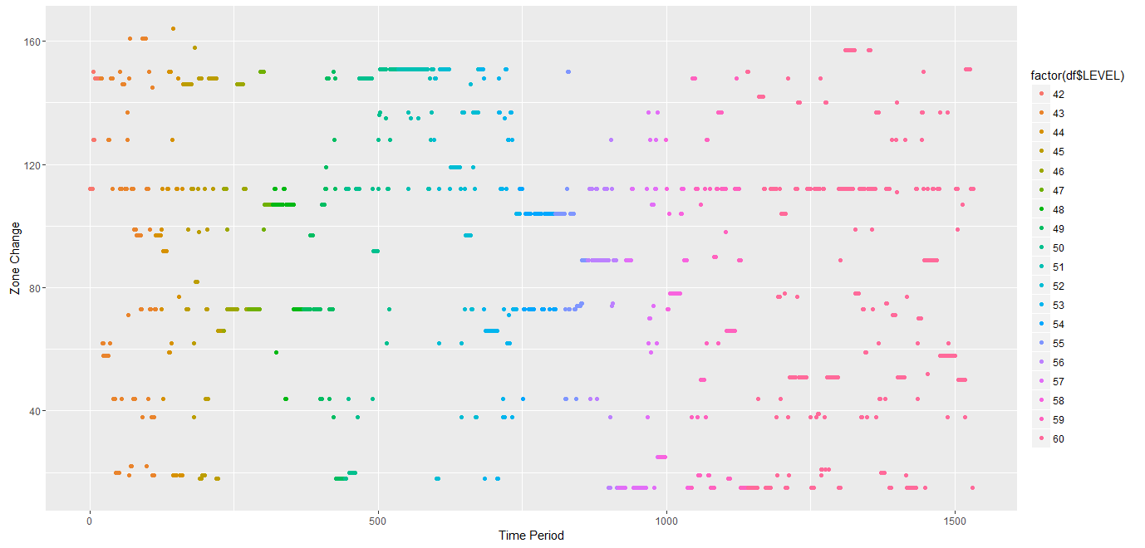
World of Warcraft
Dataset player ID 25

Slide 38
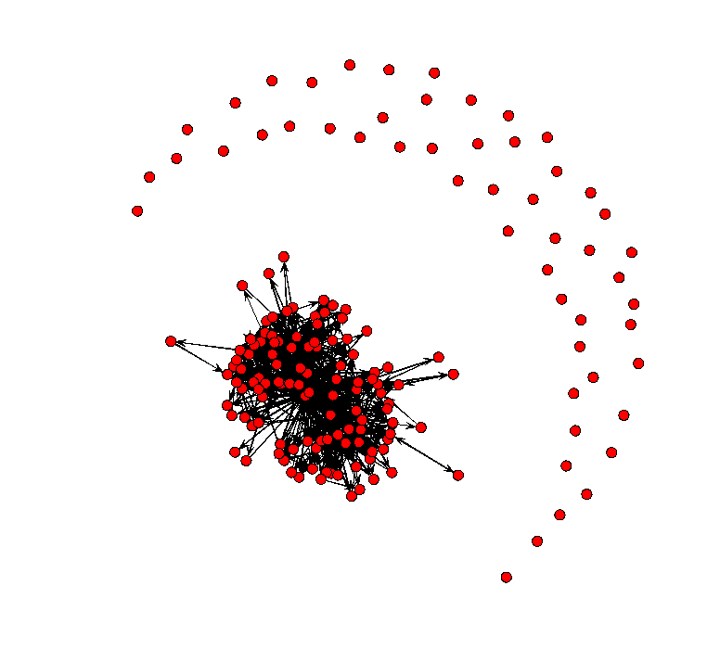
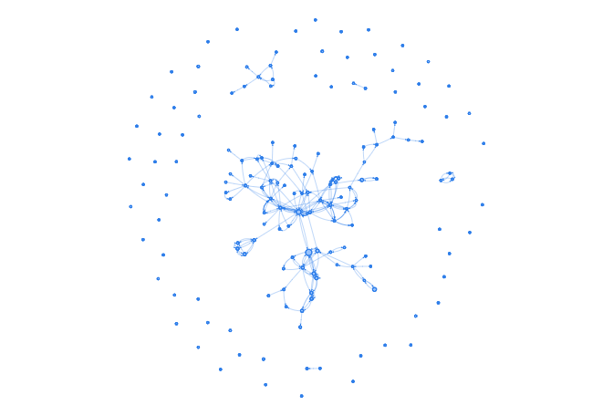
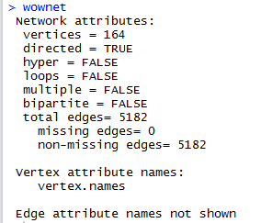
World of Warcraft
Social Network
User Behavior Network Analysis

Slide 39
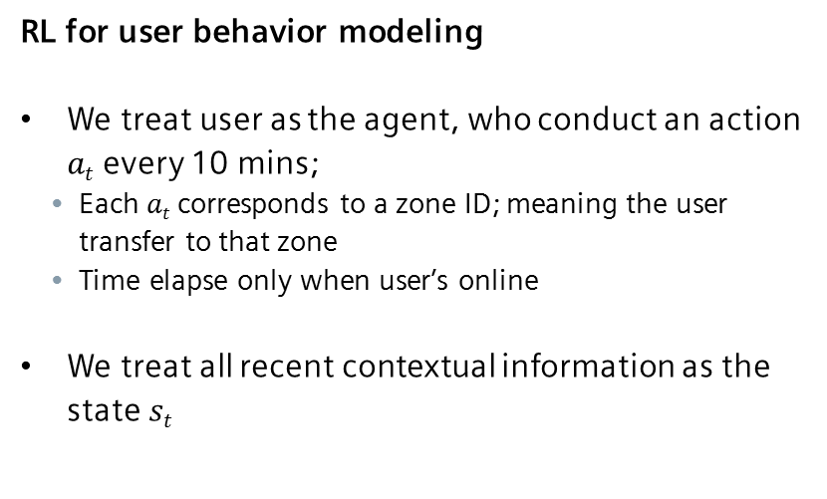
Reinforcement Learning
User Behavior Model
RL for user behavior modeling
We treat user as the agent, who conduct an action $at$ every 10 mins;
Each $at$ corresponds to a zone ID; meaning the user transfer to that zone
Time elapse only when user’s online
We treat all recent contextual information as the state $st$

Slide 40
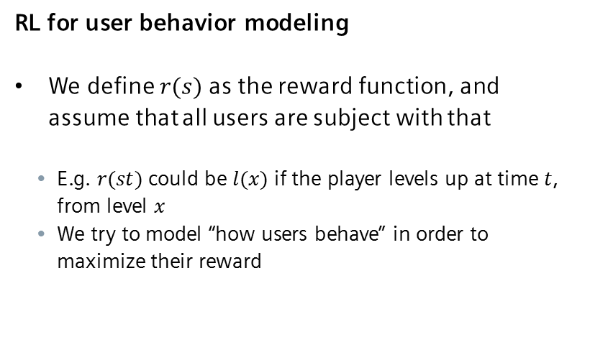
Reinforcement Learning
User Behavior Model
RL for user behavior modeling
We define $r(s)$ as the reward function, and assume that all users are subject with that
E.g. $r(st)$ could be $l(x)$ if the player levels up at time $t$, from level $x$
We try to model “how users behave” in order to maximize their reward

Slide 41
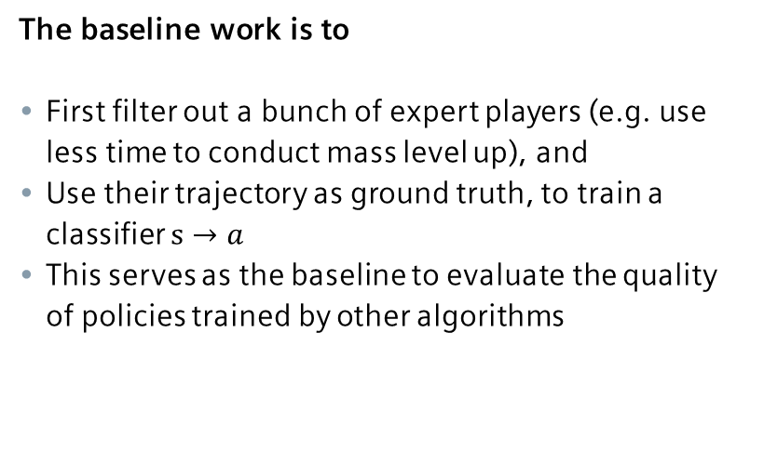
Reinforcement Learning
User Behavior Model
The baseline work is to
First filter out a bunch of expert players (e.g. use less time to conduct mass level up), and
Use their trajectory as ground truth, to train a classifier $s→a$
This serves as the baseline to evaluate the quality of policies trained by other algorithms

Slide 42
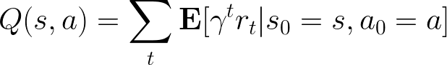
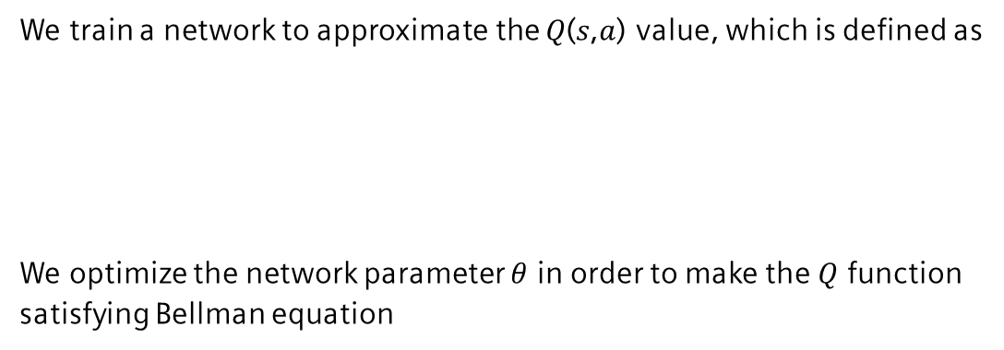
Reinforcement Learning
Training Q-Network
We train a network to approximate the 𝑄(𝑠,𝑎) value, which is defined as
We optimize the network parameter $θ$ in order to make the $Q$ function satisfying Bellman equation

Slide 43
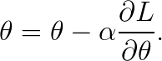
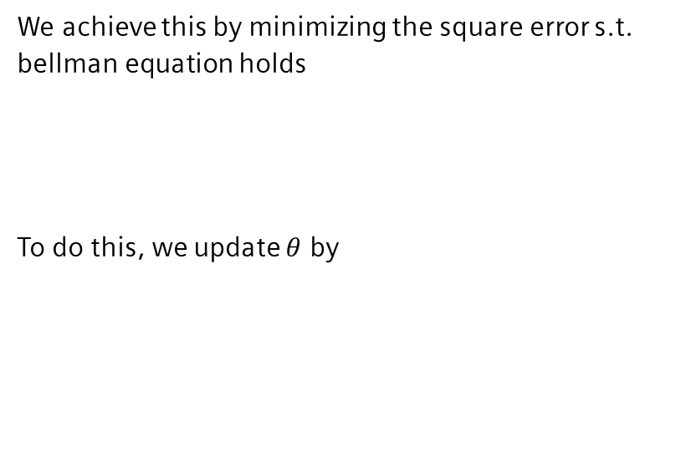
Reinforcement Learning
Training Q-Network
We achieve this by minimizing the square error s.t. bellman equation holds
To do this, we update $θ$ by

Slide 44
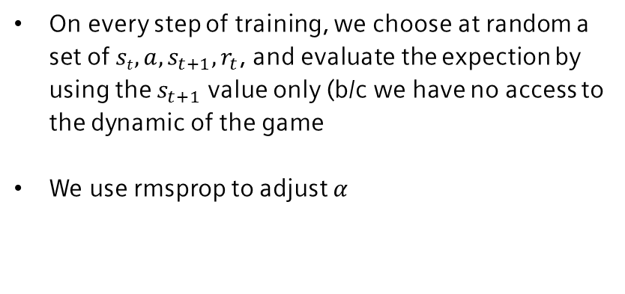
Reinforcement Learning
Training Q-Network
On every step of training, we choose at random a set of $st, a, s_{t+1},r_{t}$, and evaluate the expection by using the $s_{t+1}$ value only (b/c we have no access to the dynamic of the game
We use rmsprop to adjust $α$

Slide 45
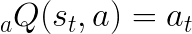
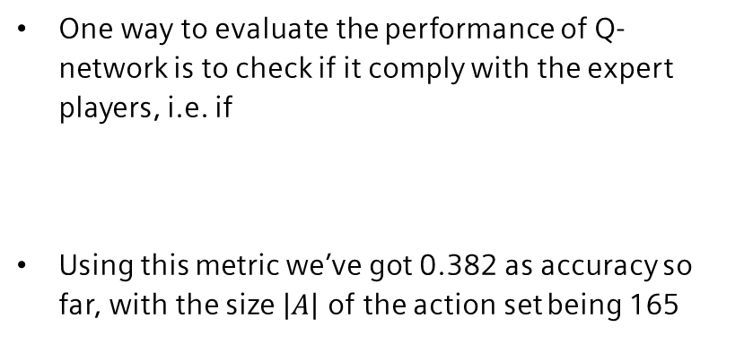
Reinforcement Learning
Policy Induced by Q-Network
One way to evaluate the performance of Q-network is to check if it comply with the expert players, i.e. if
Using this metric we’ve got 0.382 as accuracy so far, with the size $\left|A\right|$ of the action set being 165

Slide 46
Reinforcement Learning
Policy Induced by Q-Network
One way to evaluate the performance of Q-network is to check if it comply with the expert players, i.e. if
Using this metric we’ve got 0.382 as accuracy so far, with the size $\left|A\right|$ of the action set being 165

Slide 47



Reinforcement Learning
Recovering $θ$
Given a set of players we are interested in e.g. experts, entertainers, etc., we try to recover the $θ$ value under which they conducted the behaviors
Assume they are trying to maximize the reward $θ^{T}φ(s)$, we find the optimal $θ$
s.t.

